Slide 1
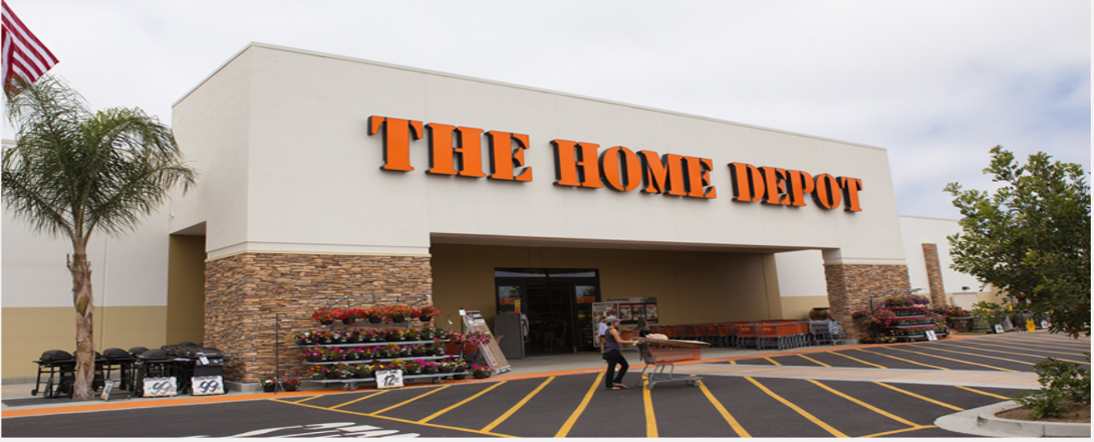


MIS 531 - Enterprise Data Management Final Project
Team 7
Datacats

Slide 2






OUR TEAM
NEHA
MINITA
SMRUTI
DATACATS
APOORVA
TEJASWINI
RASHMI

Slide 3

A G E N D A
01
Client requirements
02
Conceptual Design
03
Logical and Physical Design
04
Queries, Triggers, Procedures
05
Front End Demo

Slide 4
C L I E N T R e q u I r e m e n t s
Navigating Complexity for Customer Satisfaction
Streamline operations and track highest grossing products for customer satisfaction and retention
Synchronizing data across
diverse roles
The Inventory Challenge
Employee management system that ensures accuracy, efficiency, and monitoring employee performance
Seamlessly track products from suppliers - warehouses - store - customers for demand supply optimization
Aligning Products for Sales Optimization
Orchestrate online and in-store products, to craft promotions at a product level that resonate with higher sales.

Slide 5
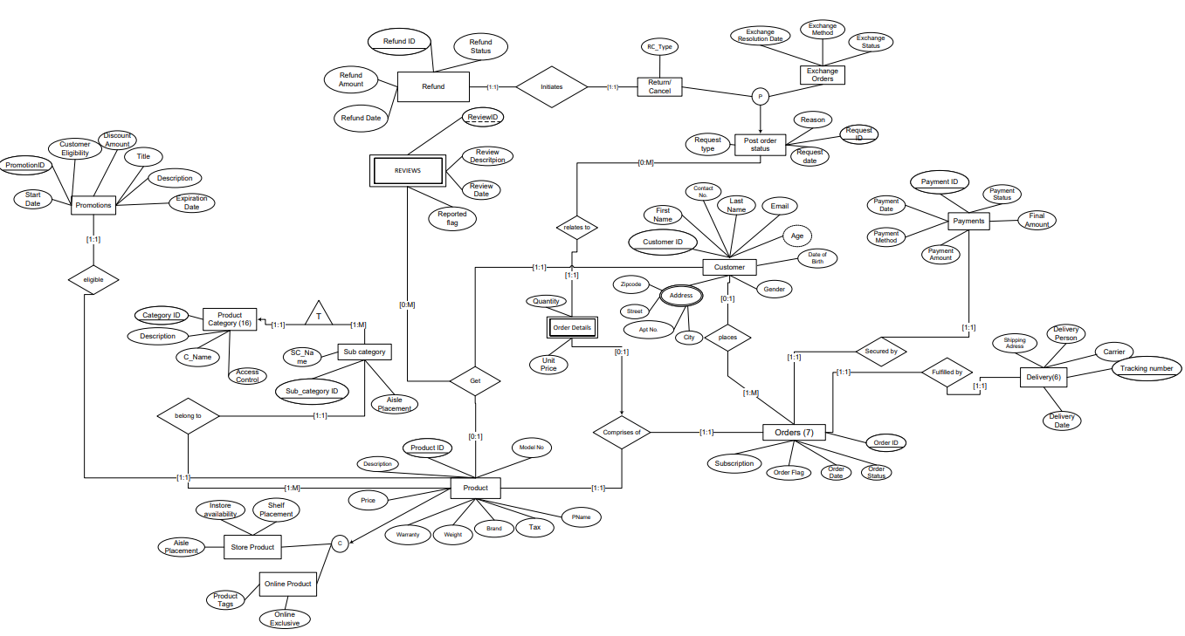
Conceptual Design – CUSTOMER Focus​

Slide 6
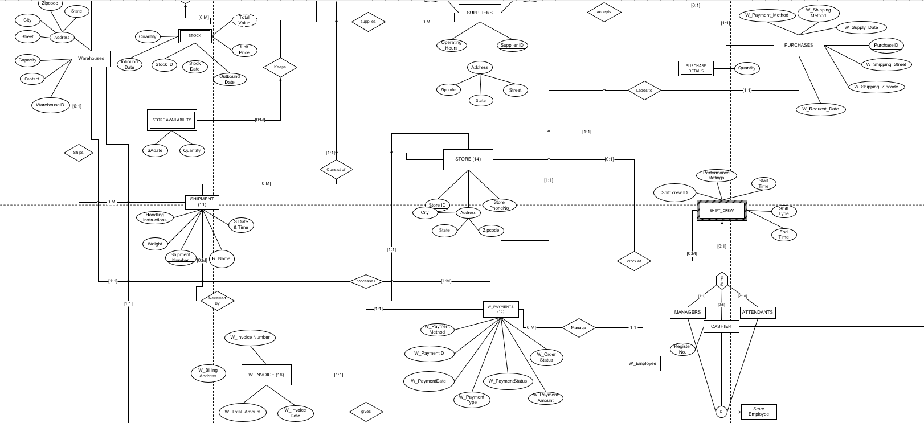
Conceptual Design – Inventory Focus​

Slide 7
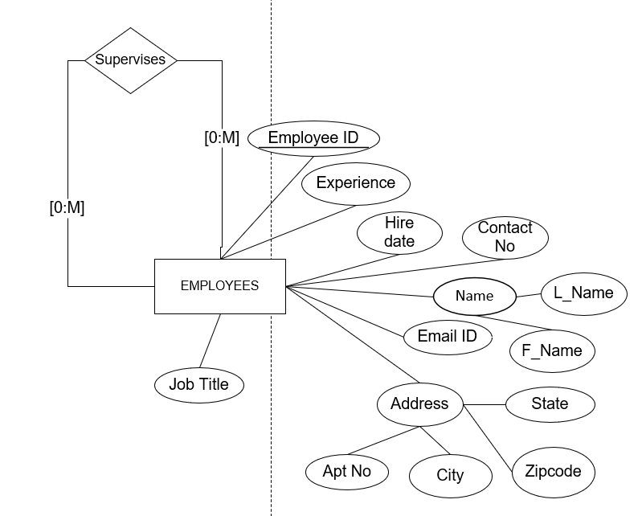
LOGICAL DESIGN
CUSTOMER (CustomerID, Contact_No, Email, Age, DOB, Gender, First_Name, Last_Name)
Unique constraint (Email)
CUST_ADDRESS (CustomerID ,AptNo, city, street, zipcode)
Foreign key CustomerID references Customer (CustomerID)
POST_ORDER_STATUS (RequestID, Request_Date, Reason, OrderID, ProductID, Type)
Foreign key ProductID references ORDER_DETAILS (ProductID)
Foreign key OrderID references ORDER_DETAILS (OrderID)
EXCHANGE_ORDERS (RequestID, Exchange_Status, Exchange_resolution_date, Exchange_method)
Foreign key RequestID references POST_ORDER_STATUS (RequestID)
RETURN_CANCEL (RequestID, RC_type, RefundID)
Foreign key RequestID references POST_ORDER_STATUS (RequestID)
Foreign key RefundID references REFUND (RefundID)
EMPLOYEES (Employee_ID, Job_title, experience, Email_ID, contactno, hiredate, l_name, f_name,
street, city, zipcode, AptNo)
UNIQUE constraint (Email_ID)
EMPLOYEE_SUPERVISOR (supervisorID, EmployeeID)
Foreign key supervisorID references EMPLOYEES (employeeID)
Foreign key EmployeeID references EMPLOYEES (employeeID)

Slide 8
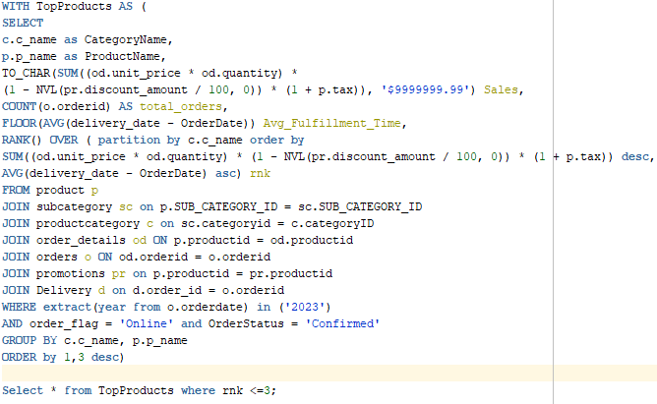
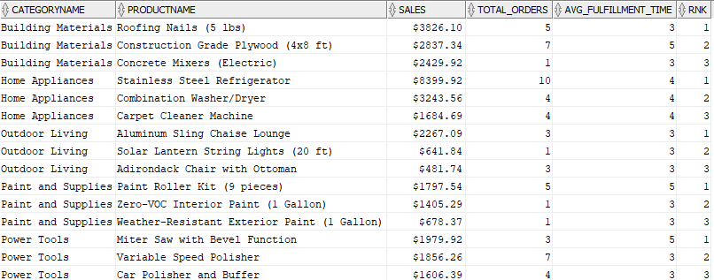
SQL QUERY 1
Displaying the online products, categorized by product category, which has shown exceptional sales performance in 2023 at Home Depot.​
This insightful analysis aids Home Depot in recognizing high-performing products in the online domain, offering strategic insights into product popularity, customer preferences, and fulfillment efficiency.

Slide 9
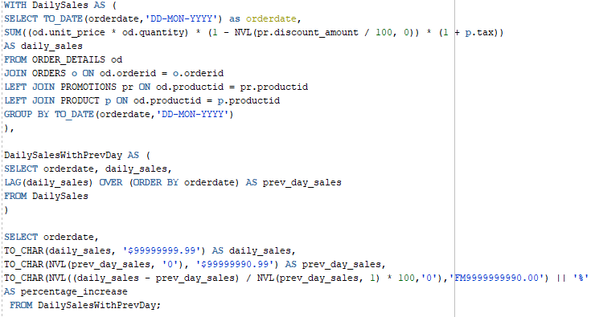
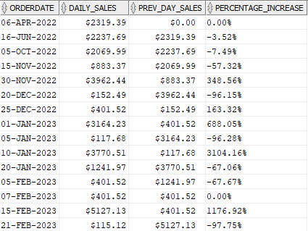
SQL QUERY 2
Displaying the daily sales at Home Depot and the percentage increase in sales compared to the previous day.​
This analysis offers Home Depot a valuable tool for understanding trends, identifying peak sales periods, and gauging the impact of promotions on daily revenue.​

Slide 10

SQL QUERY 3

Slide 11
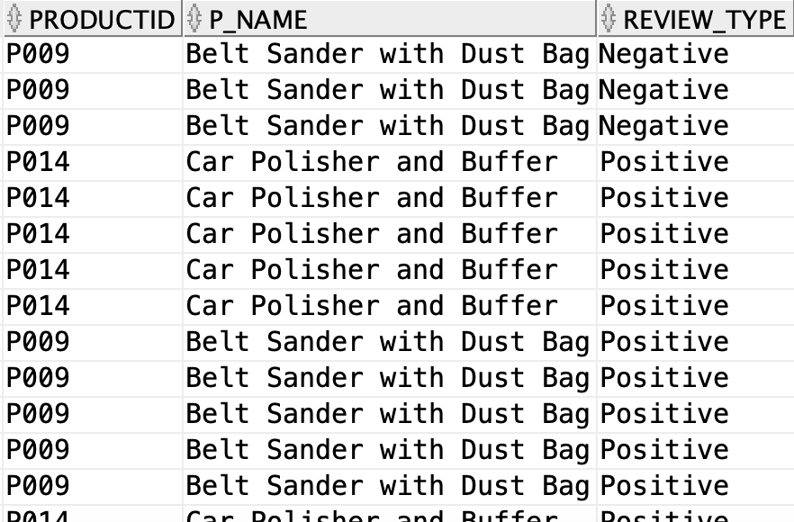
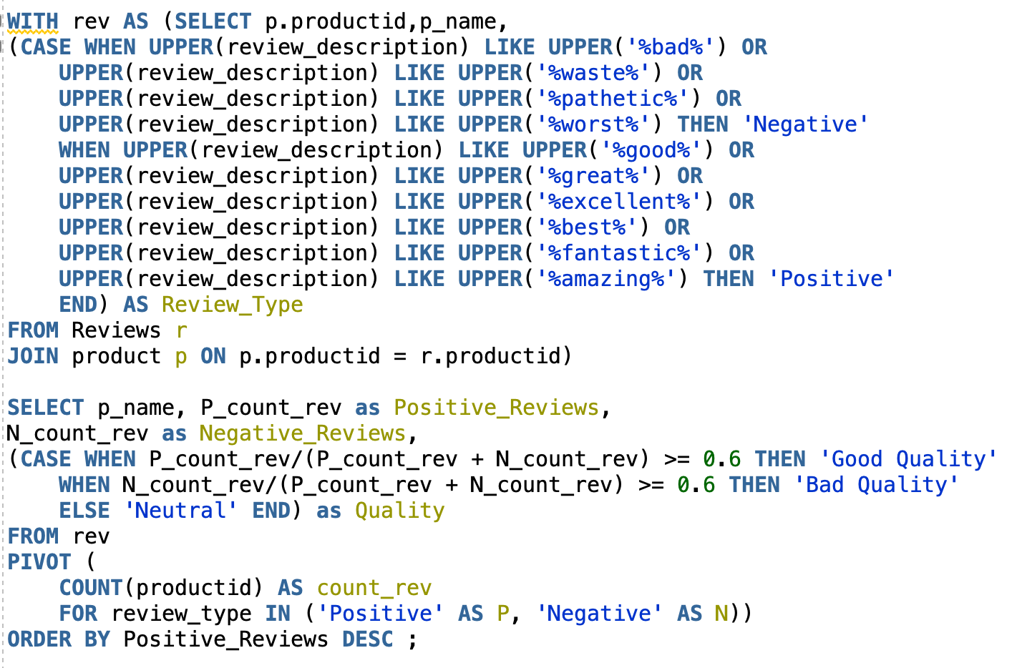
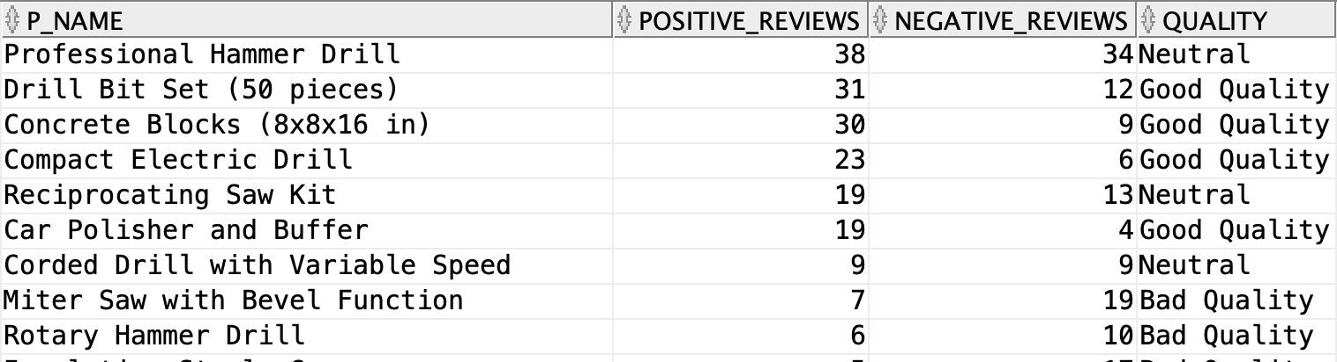
SQL QUERY 3
Assessing Product Sentiment at Home Depot.
The classification of reviews into ‘Bad’, ‘Good’, ‘Neutral’ allows Home Depot to identify trends in product quality, guiding strategic decisions for improved customer satisfaction and product refinement.

Slide 12
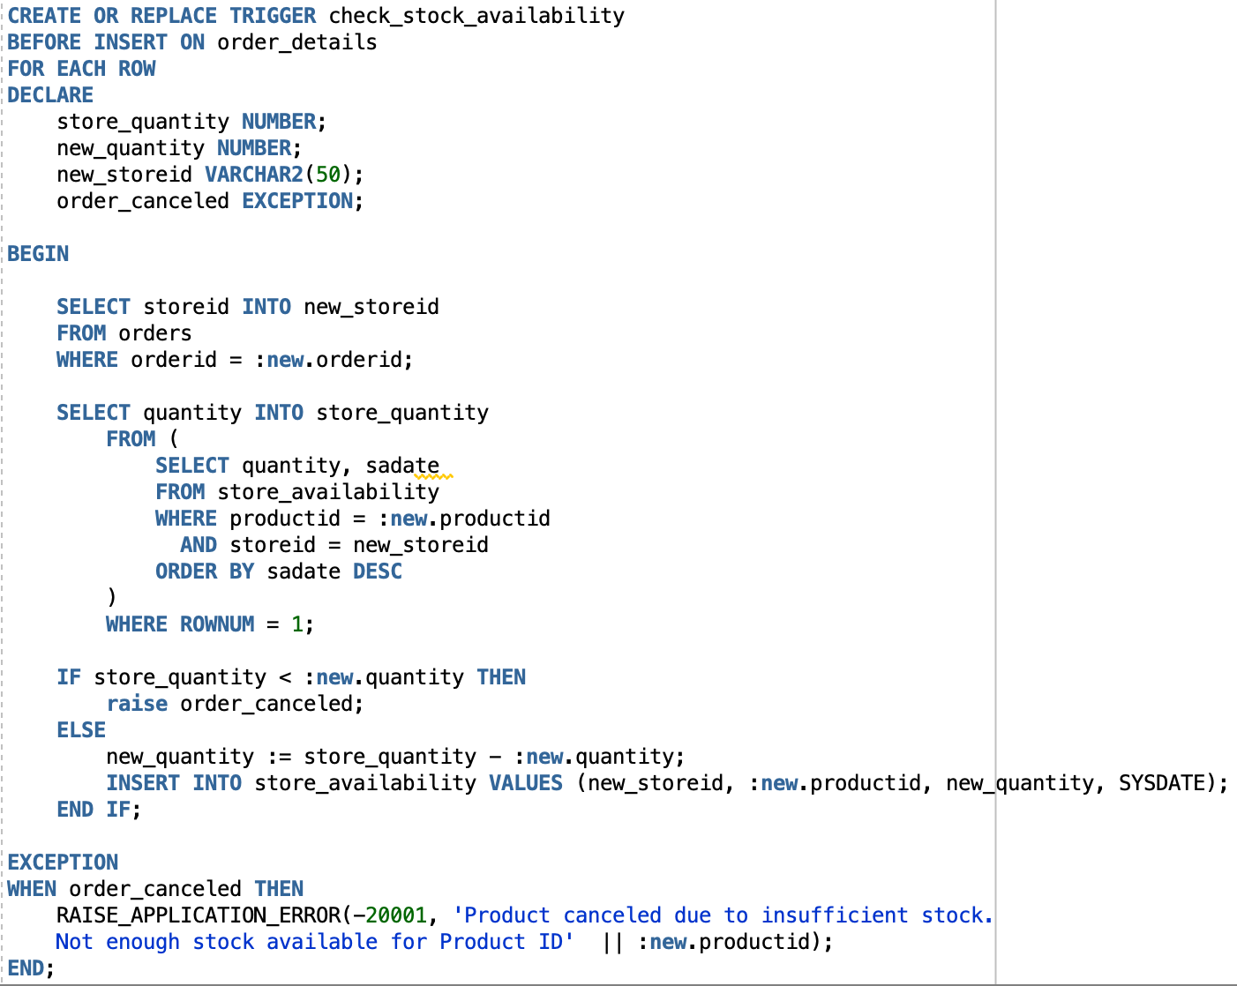
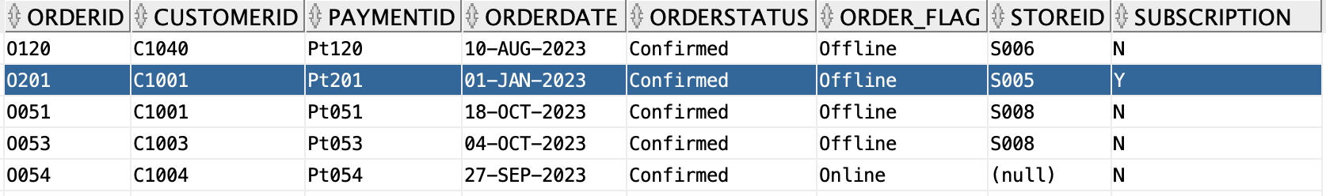
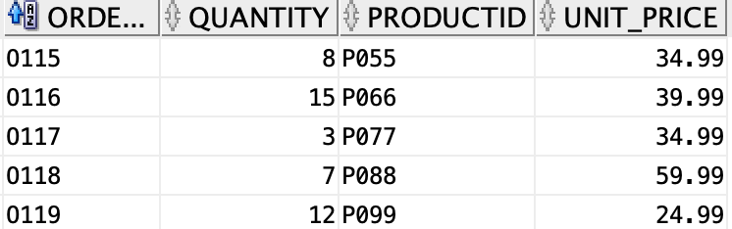
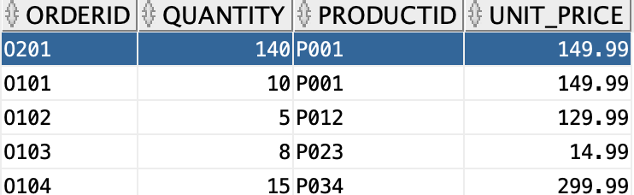
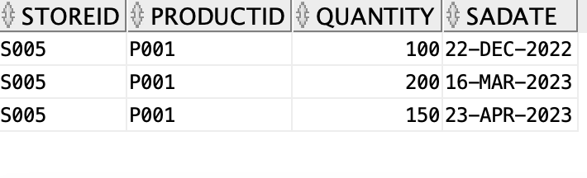
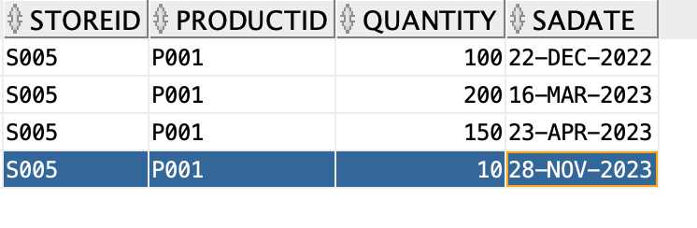
Trigger 1
Trigger checks the quantity of the product in the store before inserting in the order_details table
ORDER_DETAILS
STORE_AVAILABILITY

Slide 13
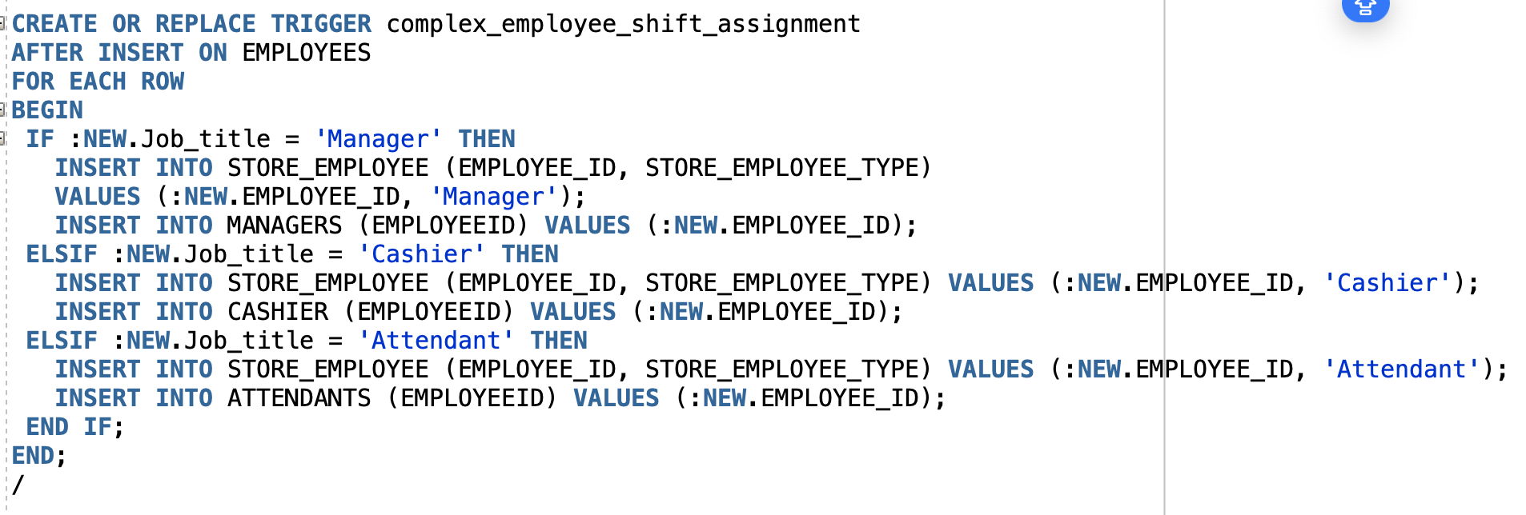
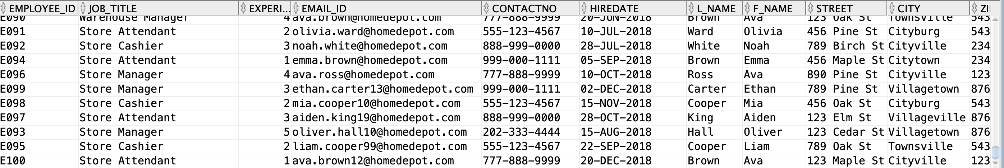
Trigger 2
Trigger inserts the employees as per their job titles and inserts them into their respective tables
Employees Table

Slide 14
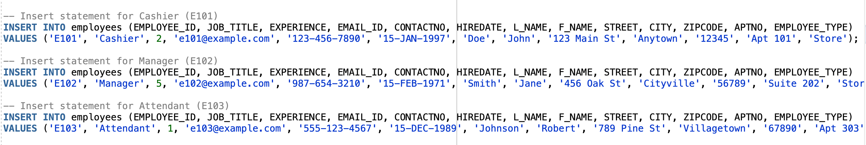
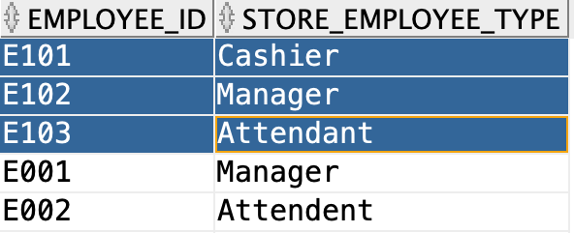
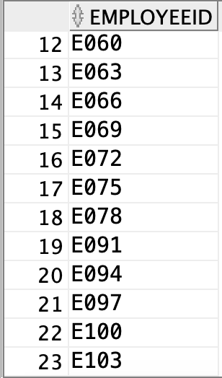
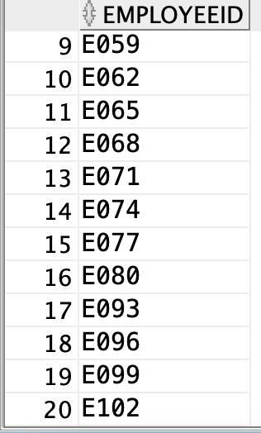
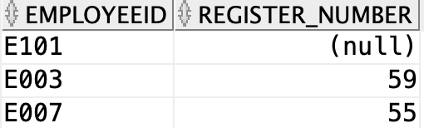
Trigger 2
Store Employees Table
ATTENDANTS
MANAGERS
CASHIER

Slide 15
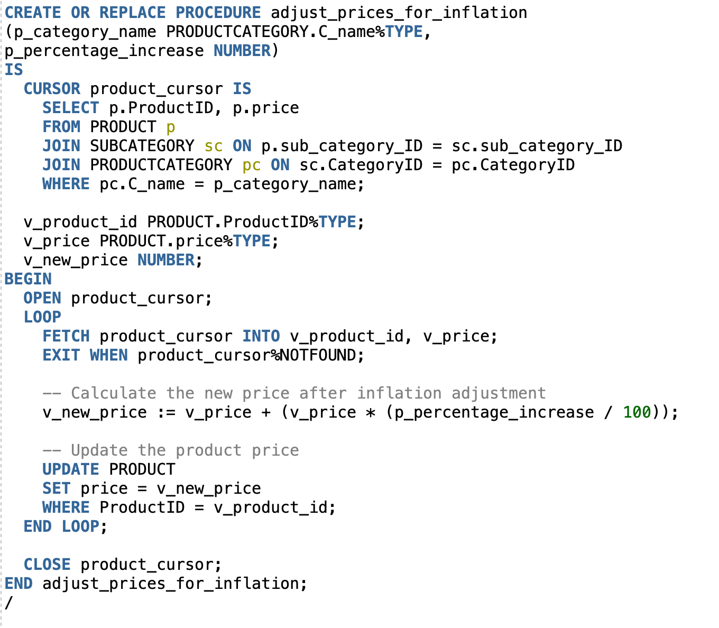
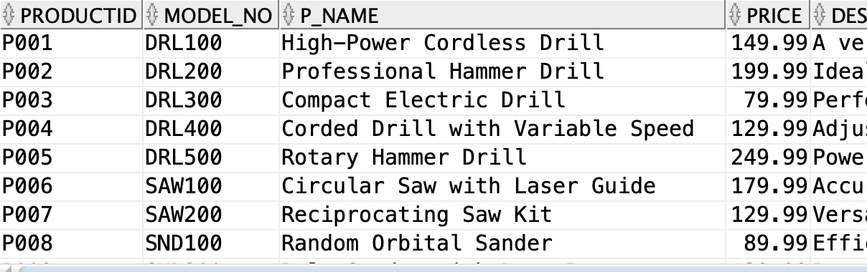
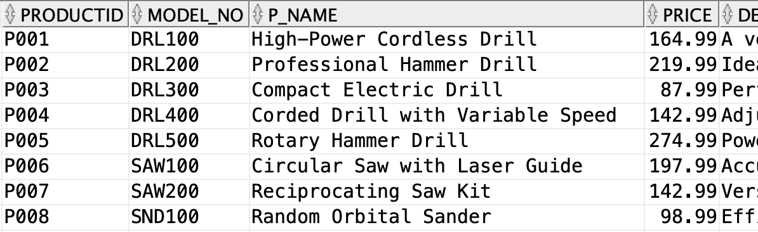
PROCEDURE
Procedure allows to increase the cost of all the products in the given category by a fixed rate of increase

Slide 16
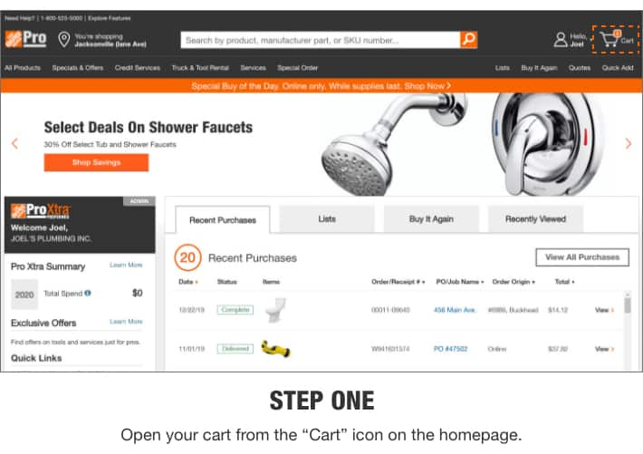
F R O N T - E N D D E M O

Slide 17



C O N C E P T S O V E R V I E W
PIVOT
LEAD/LAG
RANK
ROLL UP
ON CASCADE DELETE
UNION, MINUS
IN LINE SELECT
FETCH FIRST
WITH
PARTITION BY
DDL CONSTRAINTS
HAVING
SUBQUERY
COALESCE/CONCAT
CASE - WHEN, THEN
UPPER

Slide 18


x
We are now
open to questions

Slide 19

Adieu from the datacats

